Slide 1
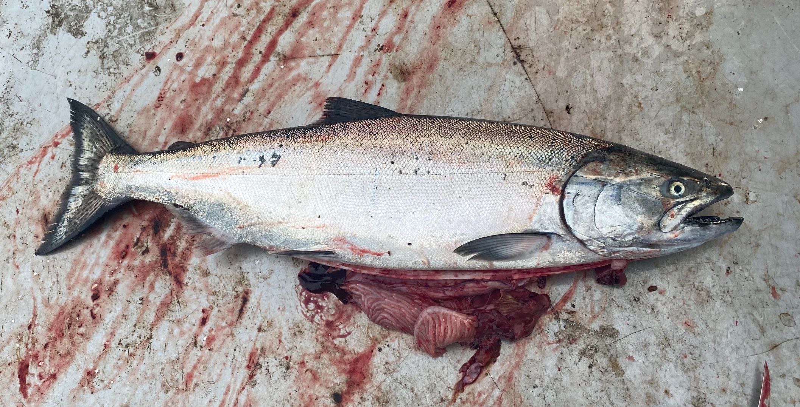

Adult Salmon Diet Program
ES 482/582 Data Project (UVic) By Rebecca Hansen and Jessica Qualley April 3, 2020
Notes:
First, we would like to acknowledge Will Duguid, Katie Innes, Micah Qunidazzi, Nick Bohlender, and Francis Juanes for spearheading and supporting the Adult Salmon Diet Program.
The adult Chinook and Coho Salmon Diet Program (Juanes Lab) seeks to address basic knowledge gaps in our understanding of what salmon eat in this region by sourcing stomach samples collected by the recreational fishing community.
The goal is to gather regional, seasonal and interannual diet data to monitor ecosystem response to environmental change.

Slide 2
How does Chinook size, catch location and time of year in the Salish Sea affect the size of herring prey consumed by Chinook salmon?
Response vs. Explanatory Variable | Hypotheses
Herring size vs. salmon length | positive, linear
Herring size vs. collection day of year | positive, linear
Herring size vs. longitude | negative, linear nonlinear
Interactions
Salmon length : latitude
Salmon length : longitude
Salmon length : collection day of year
Notes:
Pacific Herring have been found to be the dominant fish consumed by Chinook Salmon throughout regions of the Salish Sea, throughout the year.
For this project we will investigate factors that may be important to the size of herring consumed by Chinook Salmon.
We want to know how Chinook size, catch location and time of year in the Salish Sea affect the size of herring prey consumed by Chinook salmon.
We hypothesize that herring size will be positively linear with salmon length, collection day of year and latitude. However, a negative linear relationship with longitude may occur because more herring are known to distribute along western Strait of Georgia. Alternatively, a non-linear relationship with longitude is possible if maximum herring size occurs in mid-channel waters.
We also expect an interaction between salmon length and latitude, because of higher productivity in northern regions. An interaction between salmon length and longitude is possible if mainland and Vancouver Island stocks differ in size. We expect an interaction between salmon length and day of year as each age class grows.

Slide 3
Description of Data
Data collection
Herring otoliths
Recreationally-caught salmon catch data
Response variable
Otolith width (mm) ~ proxy for herring size
Explanatory variables
Collection day in 2018
Salmon length (cm)
Latitude
Longitude
Notes:
We will be assessing the relationship between herring size consumed by Chinook Salmon in the Salish Sea over the 2018 year.
The size of herring is estimated using otolith width (mm) measurements. Otoliths are paired aragonitic structures that grow inside the cranium of most teleost fishes like the rings of a tree. They are commonly used by fisheries scientists to assess growth trajectories, age and even migration patterns of individual fish. Previous work in our lab has found a positive, linear relationship between otolith width (mm) and length (mm) of herring from this dataset, and therefore we will use averaged left and right otolith width (mm) measurements from individual herring as a proxy for herring size in this analysis.
We will model the response of otolith width to associated salmon catch data recorded by each angler and linked to each stomach sample. Explanatory variables include salmon catch day in the 2018 year, salmon length, longitude and latitude.
We will only look at Chinook Salmon collected in the Canadian Salish Sea during the 2018 year.

Slide 4
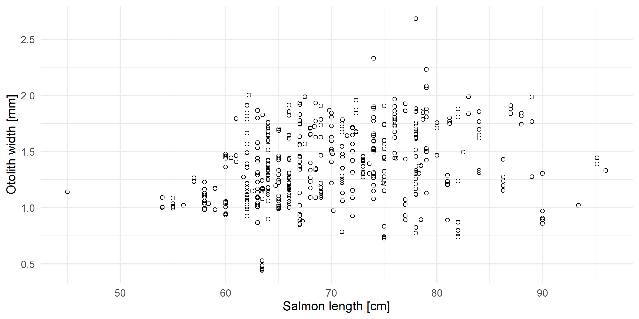
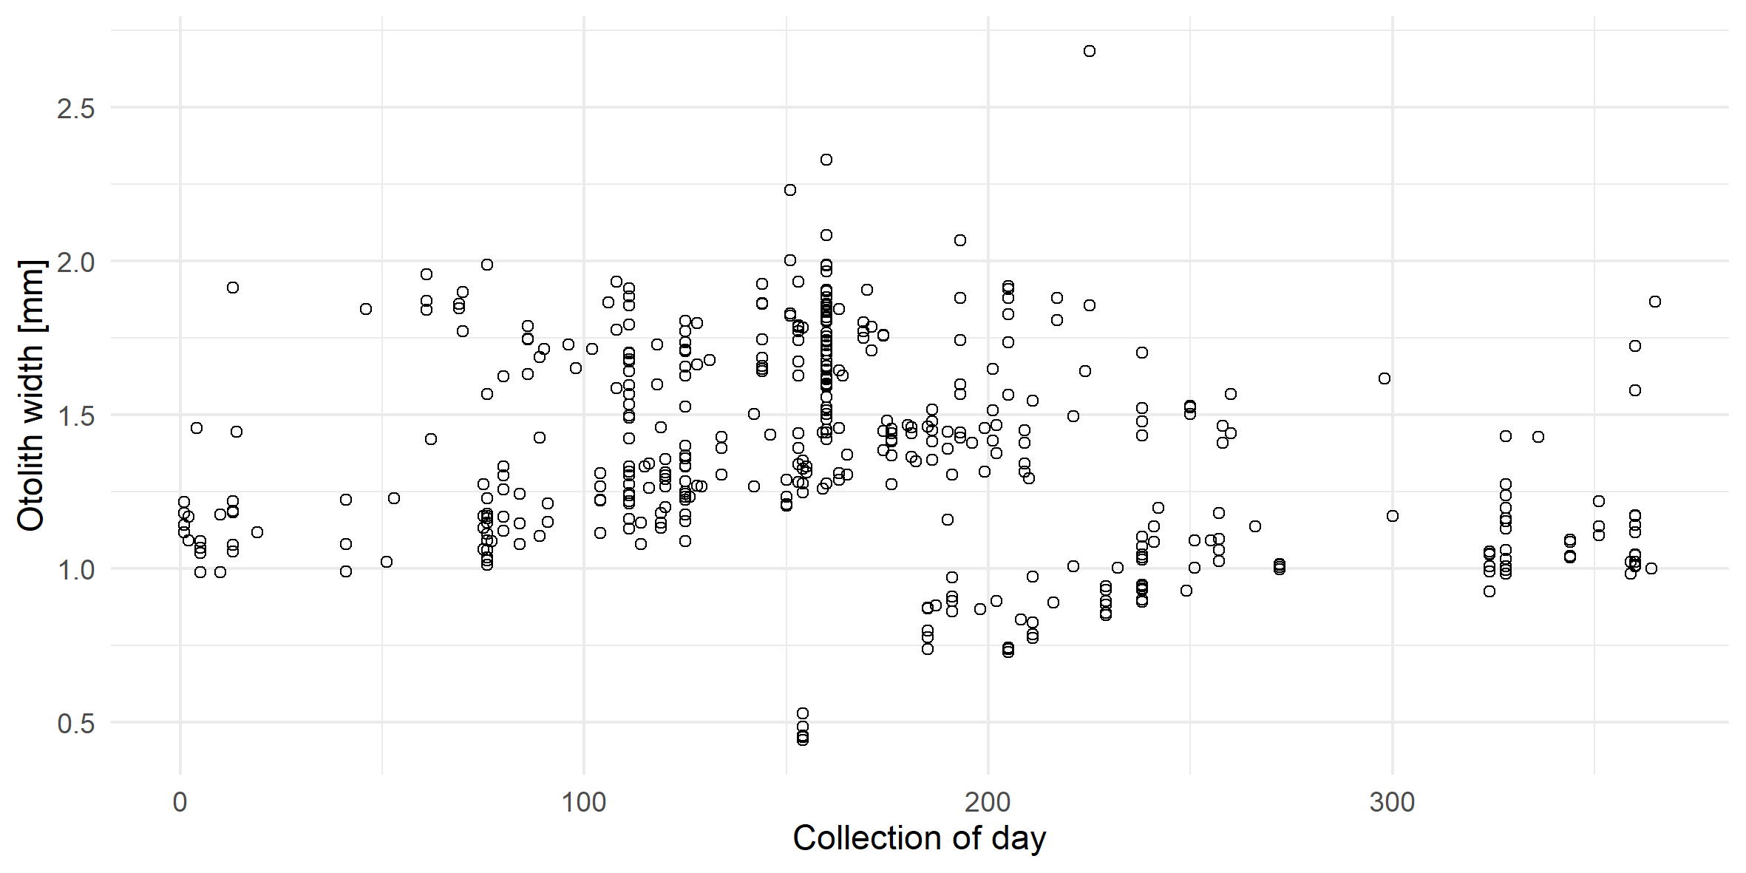
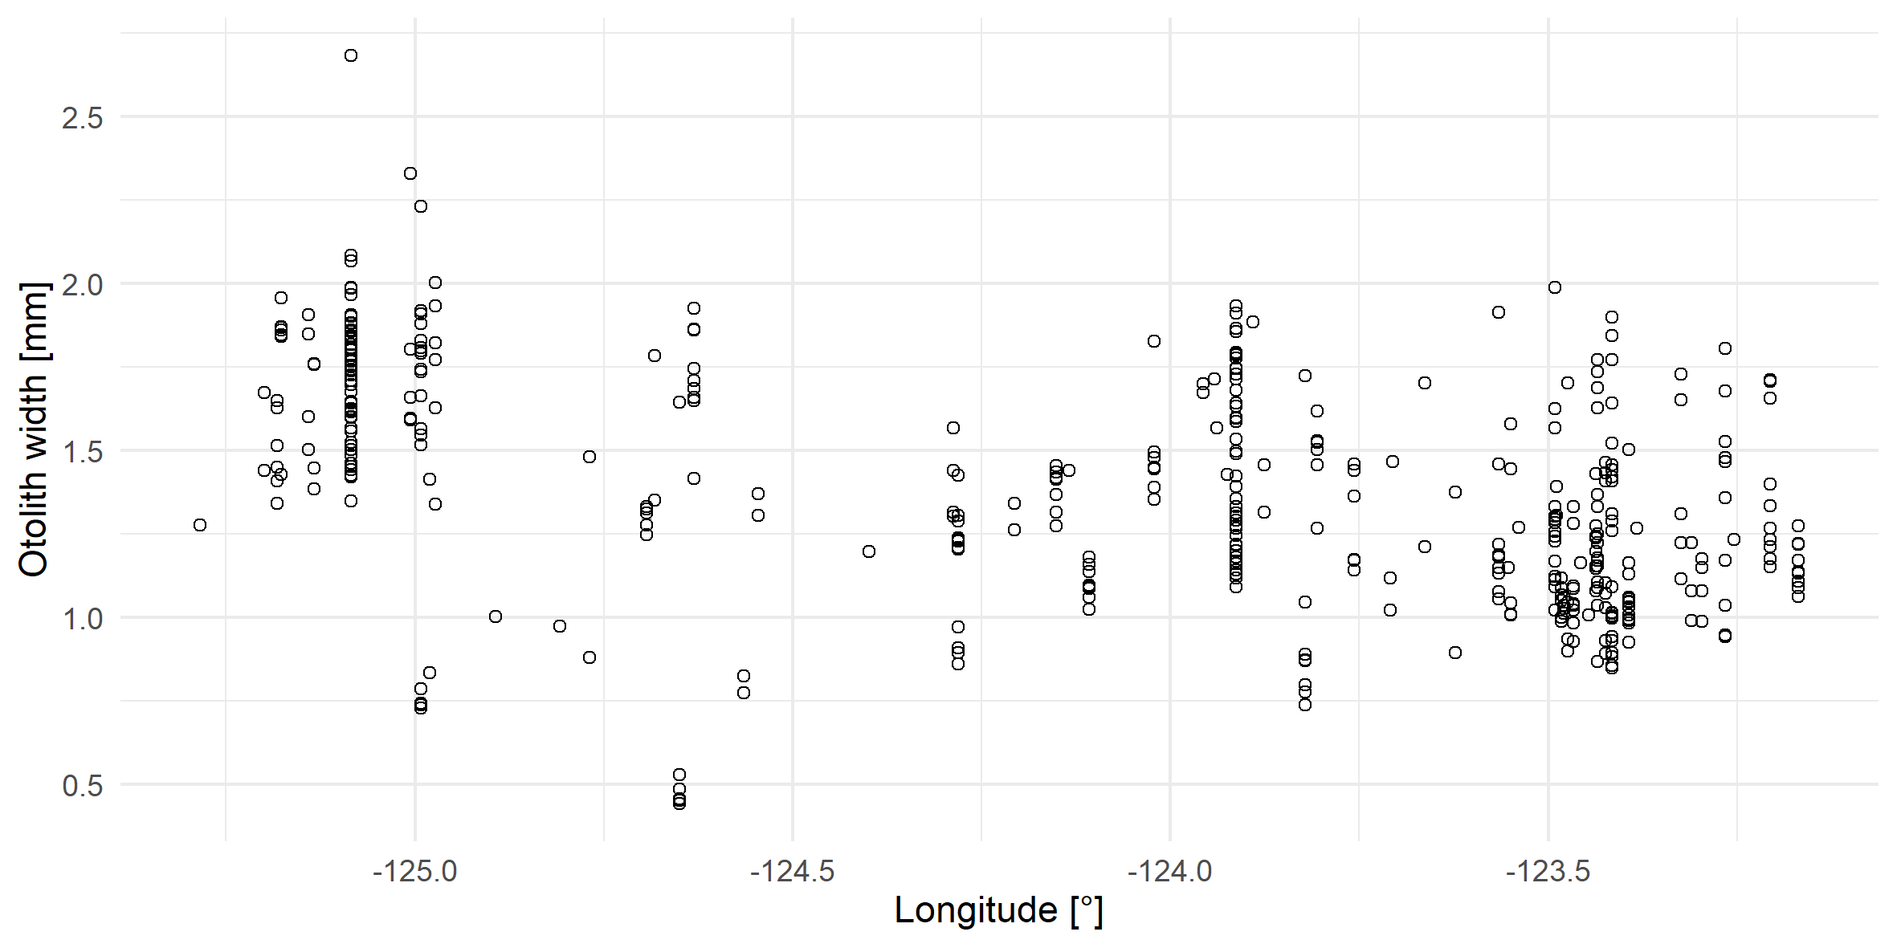
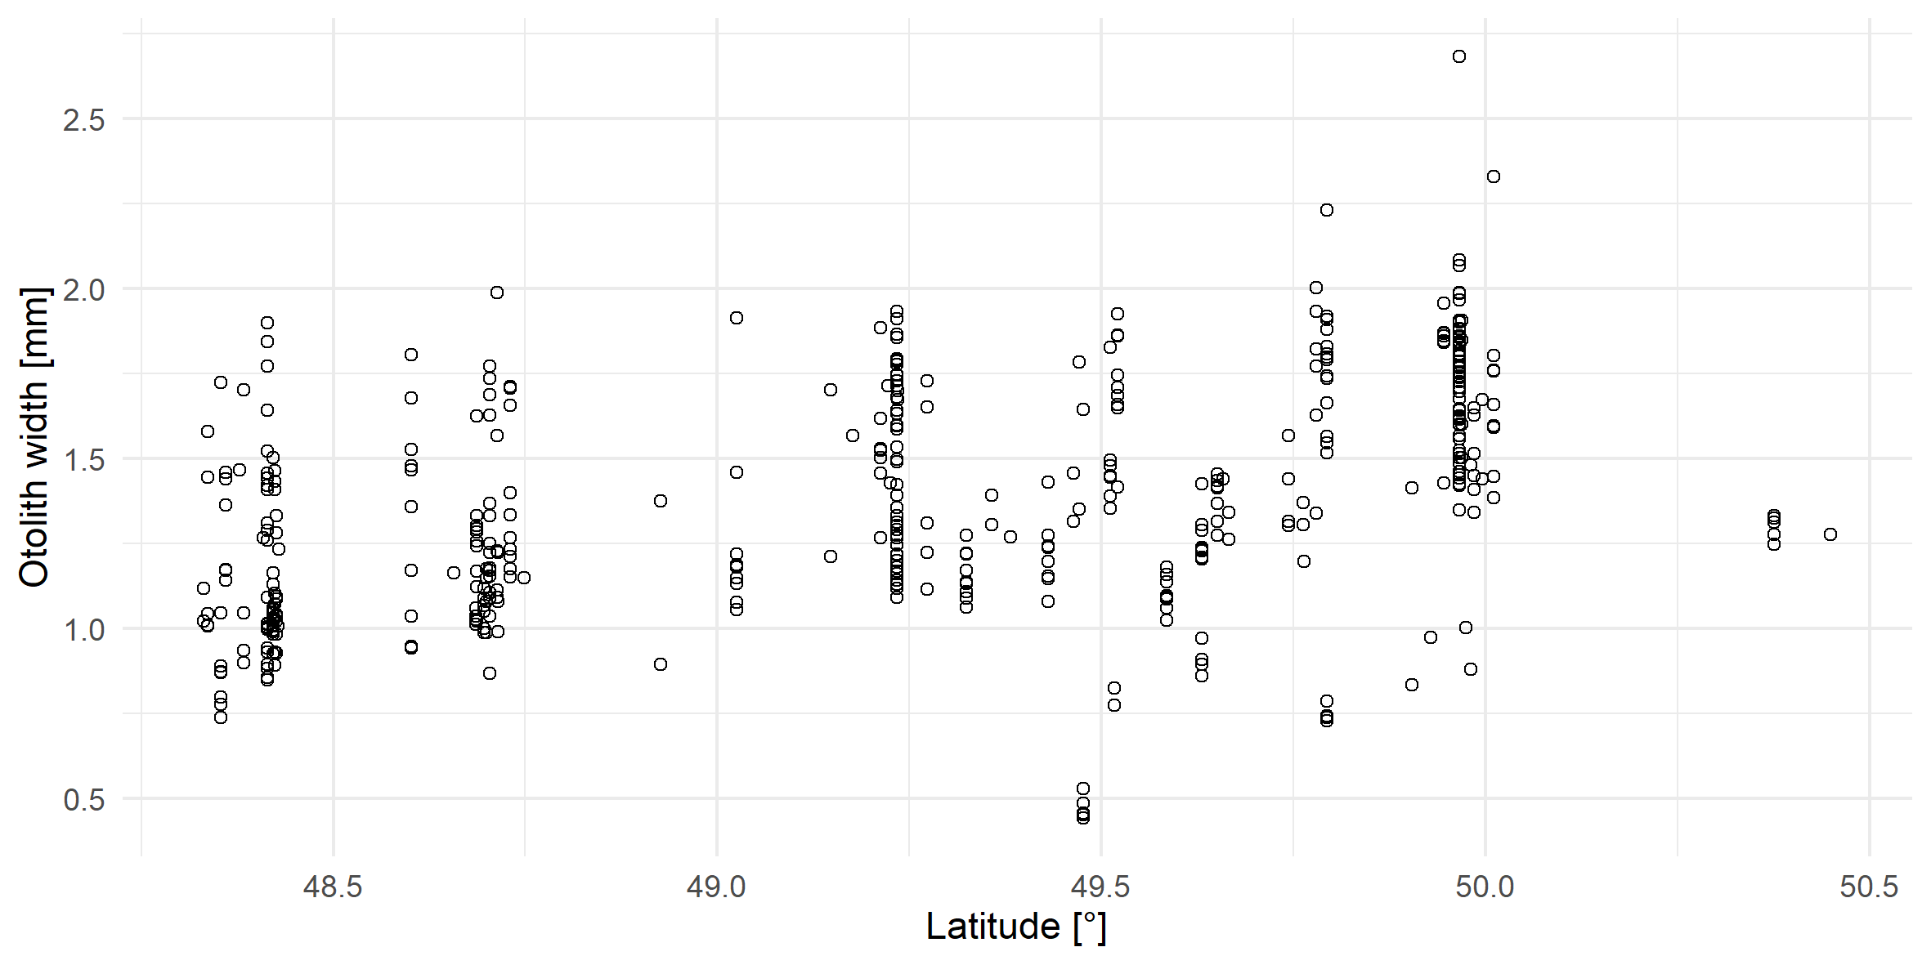
Describing the data
Notes:
Model 11 and 6 coefficient plots show that longitude and day of year have a small, negative relationship with otolith and therefore are useful predictors since the confidence intervals do not overlap with zero.
However, salmon length is not a useful predictor as the confidence interval overlaps with zero. Although, salmon length does have a small positive relationship with otolith width.

Slide 5
Statistical Methods
1. Linear mixed-effects models fit with maximum likelihood estimation
Random intercept corresponding to salmon ID
2. Akaike Information Criterion (AIC)
Advantages of LME and AIC?
Response normally distributed
Compare complex, non-nested models
Common in ecosystem studies where parameter estimates imprecise
Notes:
We used AIC to compare candidate linear mixed-effects models fit with maximum likelihood estimation.
We included a random intercept corresponding to individual salmon (salmon id) to avoid autocorrelation from non-independence of multiple herring that may occur in a single salmon or experimental unit. It is likely that multiple herring in one stomach have similar sizes if they travel in the same school targeted by an individual salmon. Also, salmon id had greater than 10 levels suggested by Zuur et al. (2007) to be suitable characteristics of a random intercept.
We used a linear mixed-effects model as we assumed a normal probability distribution of our response variable, otolith width (mm) and explanatory variables show few missing values or outliers.
We chose AIC because it is flexible when comparing complex, non-nested models with parameters estimated from ecological field studies. AIC is also commonly used in ecosystem studies where parameter estimates are relatively imprecise. We accept that the optimal AIC model may be selected over the true model, given the current sample size and our ecological understanding of the system.

Slide 6
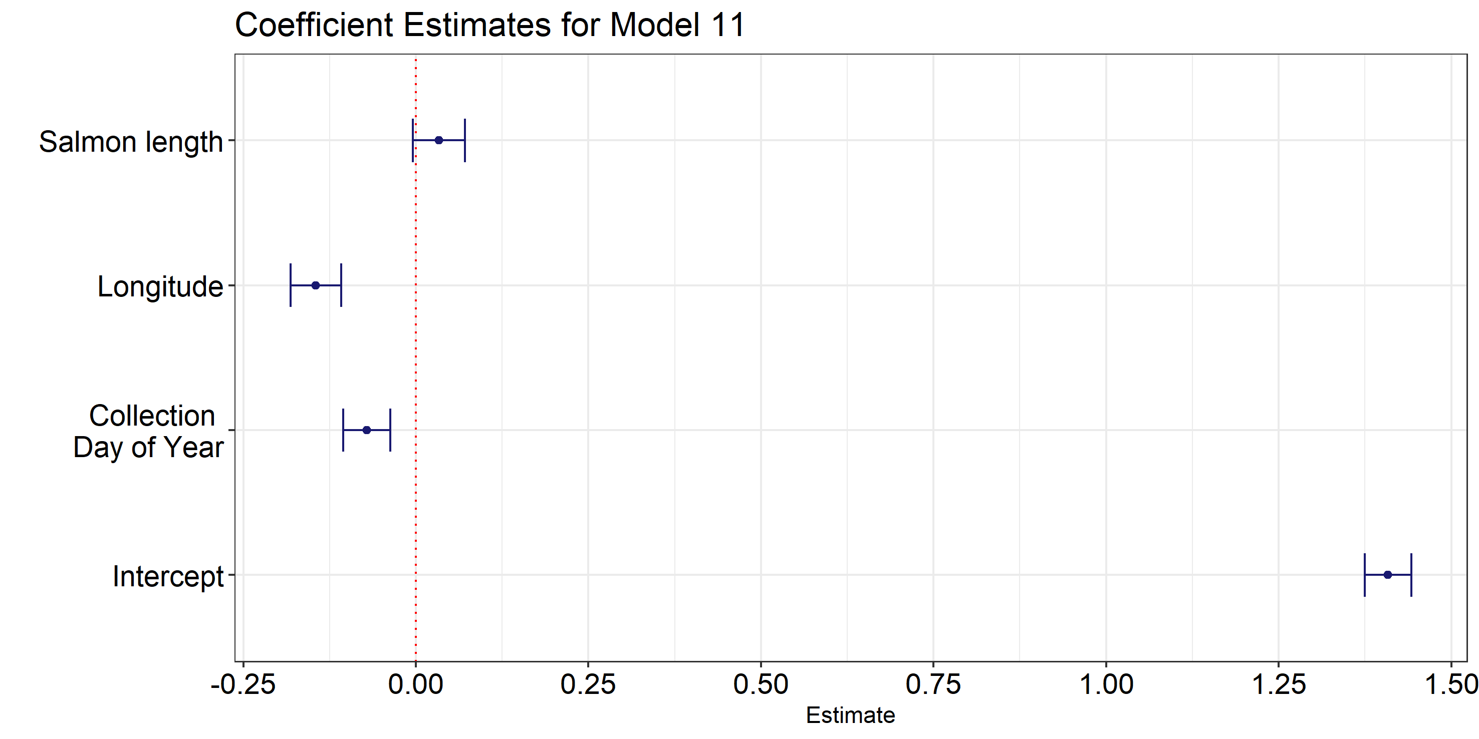
Results
AIC test
Model 11 <- oto.width ~ day of year + longitude + salmon length + random effect (salmon ID)
Model 6 <- oto.width ~ day of year + longitude + random effect (salmon ID)
Coefficient estimates of model: Model 11
Notes:
AIC shows that model 11 and 6 best explain variation in otolith width/herring size. Although, the first X models have similar delta AIC values and weights.
One thing to note is that model 11 and 6 are very similar in structure and include collection day of year and longitude. The only difference being that model 11 also includes salmon length.
One thing to consider is that these AIC results only pick the simplest model out of the set of candidate models that we decided to compare based on our understanding of the ecosystem.

Slide 7
Results
Response vs. Explanatory Variable | Hypotheses | Results
Herring size vs. salmon length | positive, linear | positive
Herring size vs. collection day of year | positive, linear | negative
Herring size vs. longitude | negative, linear nonlinear | negative
Longitude
Collection Day of Year
Notes:
The results generally support our hypothesis for a positive relationship between otolith width versus salmon length and negative linear relationship with longitude.
However, the negative relationship between otolith width and collection day contradict our hypothesis of a positive relationship between these variables.
None of these relationships appeared to be linear.
Interestingly, longitude better describes otolith width compared to latitude.
Therefore, we conclude that longitude and collection day of year are the best explanatory variables (tested in this statistical exercise) that describe the variation in herring size consumed by Chinook Salmon in the Salish Sea in 2018.

Slide 8
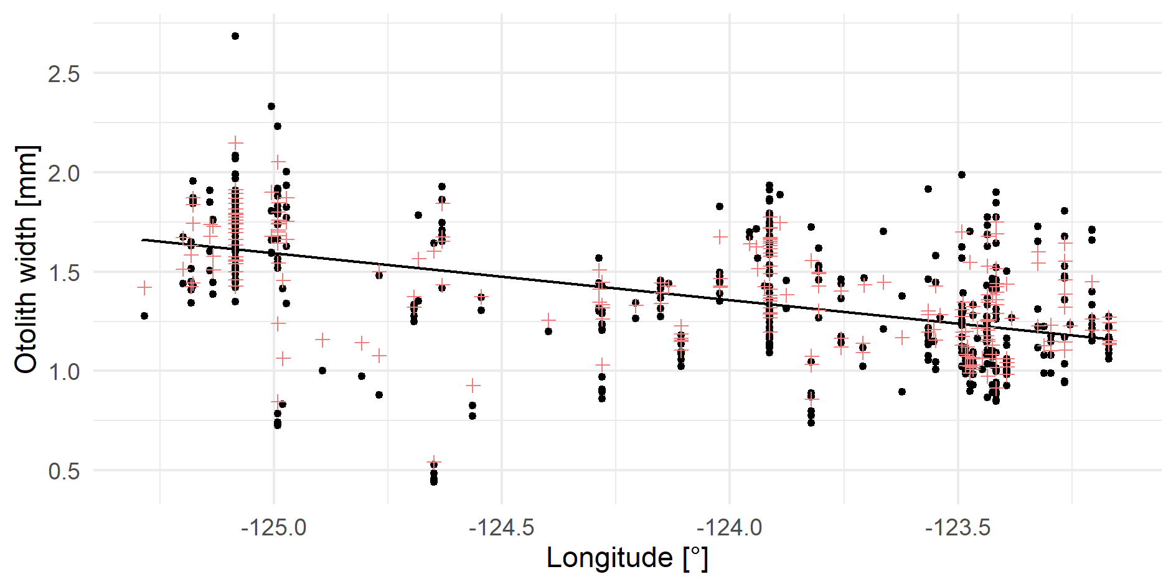
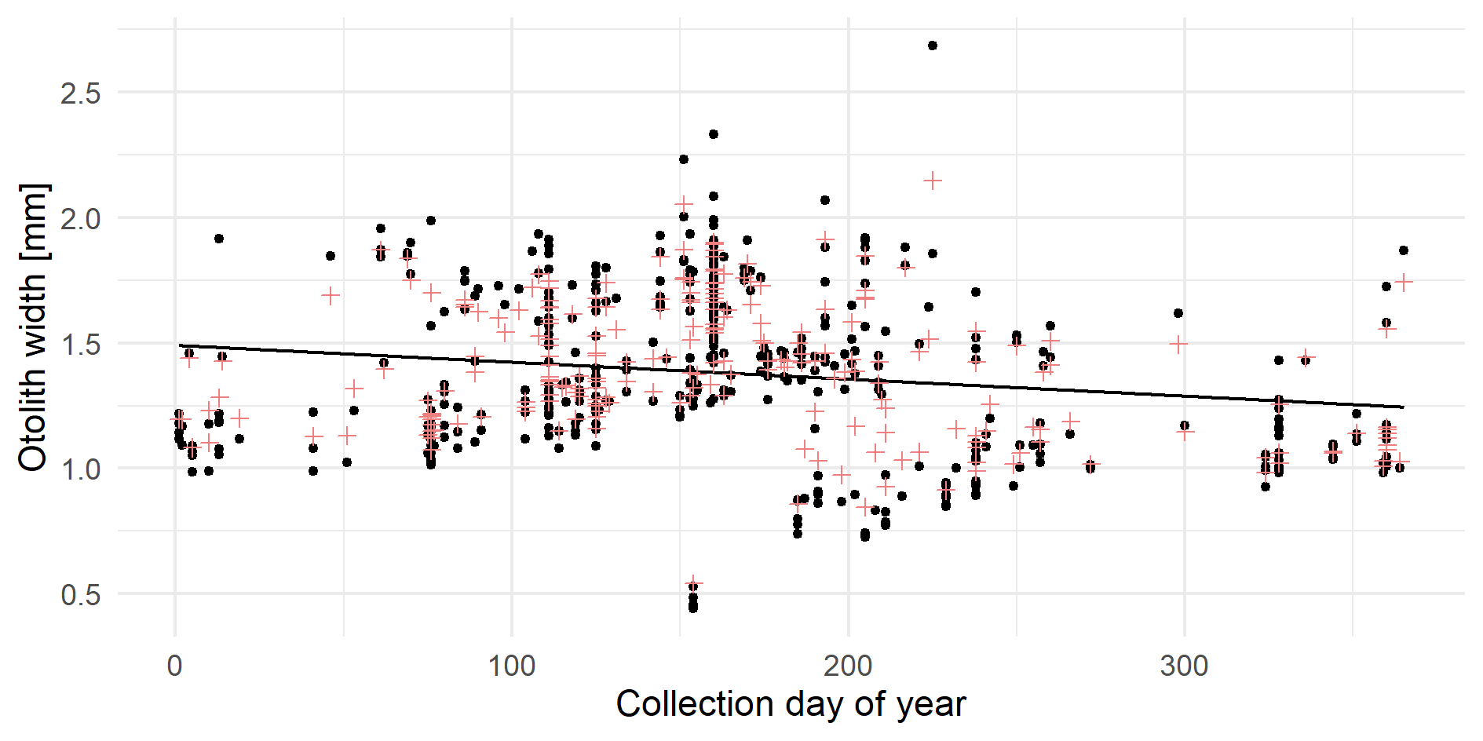
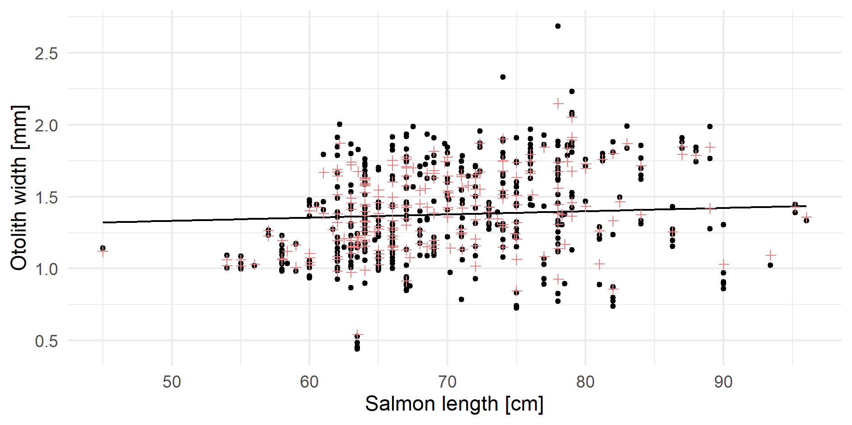
Model visualized with data: Model 11
Notes:
Both models overpredict otolith width between longitude -124.0 to -125.0.
Both model overpredict otolith width between 0 to 50 days and underpredict otolith width between 125 to 175 days.
Model 11 overpredicts for salmon between 40 cm to 60 cm.
Overall, Model 11 and 6 does not fit the data well and residual plots suggest that there are violations of linear model assumptions.

Slide 9
Limitations
Longitude – reflects spatial size distribution of herring in Salish Sea
Solution: model capture location as a categorical variable
Day of Year – reflects two or more herring age classes
Solution : model age classes separately
Salmon length – few salmon below <62cm
Solution : model with and without fish < 62cm
Notes:
The limitations of these models are that longitude is not necessarily capturing east-west patterns from shallow to deep water, but rather the spatial size distribution of herring in westerly regions near Comox Valley and easterly regions near San Juan Islands.
If we model capture location as a categorical variable instead of a continuous longitude, this will allow us to interpret regional patterns better.
Another limitation is that otolith width versus collection day may represent two or more herring age classes that are available to salmon.
If we model these age classes separately, we may see that a different set of factors are better for explaining variation in otolith width/herring size.
Alternatively, we could model herring size as a quadratic relationship.
A third limitation is that otolith width versus salmon length shows few salmon below 62cm in addition to model overprediction in this range. This could be due to gape limitation or size restrictions >62cm for recreational catch.
We may want to generate models with and without fish <62cm to determine whether omitting this subset is justified and changes our result.

Slide 10
Discussion
The importance longitude and day of year for explaining variation in herring size may reflect:
High herring abundance observed along east coast Vancouver Island
High abundance of large herring near Hornby/Denman Island during spring spawning
Small, young-of-the-year juvenile herring in June diets
Salmon length?
Not important predictor but…
Increasing prey size with increasing predator size is consistent with other studies
Notes:
The importance and relationship between otolith width/herring size and longitudinal and otolith width/herring size and day of year could be reflecting real ecological patterns related to herring in the Salish Sea.
Herring abundance is reported to be highest along east coast Vancouver Island and near Hornby/Denman Island during peak spawning in mid-March (Therriault et al. 2009).
Furthermore, a greater contribution of large herring consumed in western regions followed by the appearance of small juvenile herring entering diets, post-hatching in June may be driving the observed trends with longitude and day of year.
Although salmon length is a poor predictor of herring size consumed, the overall trend suggests prey size range increases with salmon size which is consistent with findings in other marine predators (Scharf et al. 2000).

Slide 11
Checklist
PDF file
10 slides max
2 slides of plots min
Complete sentences

